Slide 1
Bayesian Belief Network-Driven Proactive Fault Tolerance for Microservice Placement in Fog Computing
UG PROJECT WORK — PHASE I | REVIEW I
PRESENTED BY
Mohit R — 3122235002072 Rahul Akshath Rajendran — 3122235002095
PROJECT GUIDE
Dr. Sabireen H, Assistant Professor
Department of Information Technology
SSN College of Engineering, Kalavakkam
20 August 2026

Slide 2
Problem Statement
What goes wrong
• Fog nodes run latency-critical work on ordinary, exposed hardware
• A node failure loses its microservice and misses a hard deadline
• Checkpointing, retransmission, heartbeat failover: all act after the fault
Why it is hard to prevent
• Fixed thresholds on one metric fire on load spikes, miss real degradation
• Node health is never measured directly — only inferred from noisy telemetry
• A BBN needs no failure corpus, tolerates missing evidence, names the cause
• Problem statement: no fog fault-tolerance mechanism estimates the probability that a node will fail
within a given time, or uses that probability to decide placement, migration and redundancy.
Notes:
(~75 sec)
Para 1 - fog puts modules close to the sensors so latency-critical work meets its deadline, but the hosts are
ordinary hardware in uncontrolled places, and a single failure breaks a critical service.
Para 2 - existing methods are reactive. Checkpoint-and-restore, retransmission and heartbeat failover all
start recovery AFTER the fault, so the recovery time lands at the worst possible moment. The proactive methods
compare ONE measurement to a FIXED threshold: it fires on harmless load spikes, and stays silent when the node
degrades in a way that measurement does not show.
Para 3 - the real difficulty: node health cannot be observed directly. It must be inferred from several noisy,
related measurements, some of which may be missing exactly when the node is closest to failing. A Bayesian
Belief Network suits this - it can be built from expert knowledge when no failure data exists, it marginalises
out what it cannot see instead of guessing, and it tells you which condition is responsible.
Then read the problem statement at the bottom.

Slide 3
Introduction
Why fog computing is used
• Cardiac monitoring and video surveillance must react within tens of milliseconds
• A distant cloud data centre cannot meet that deadline
• Fog runs the application modules on gateways and base stations, near the sensor
Why fog nodes are unreliable
• Ordinary hardware, uncontrolled location, shared uplink, often on battery
• Mobile users hand over between nodes, so each node's load keeps changing
• They fail far more often than data-centre servers, breaking critical deadlines
Why the failure can be anticipated
• Nodes degrade first: utilisation rises, queues grow, links and energy decay
• That leaves a short window to move the microservice out
• We predict inside that window, then place, migrate and replicate on it
Notes:
(~75 sec) Three points.
1. WHY FOG. An ECG classifier or a surveillance tracker has to respond in tens of milliseconds. A round trip
to a cloud data centre is too slow. So fog computing runs the application modules on gateways, routers and
base stations, one or two hops from the sensor.
2. WHY THAT IS RISKY. A fog node is ordinary hardware in an uncontrolled place. It shares a limited uplink,
often runs on battery, and mobile users keep moving between nodes so the load keeps changing. These nodes
fail far more often than data-centre servers, and one failure can break a safety-critical deadline.
3. THE OPENING FOR OUR WORK. Nodes rarely fail suddenly. Utilisation rises, queues grow, links get worse and
energy drains first. That gives us a short window. We predict the failure inside that window and use the
prediction to place, migrate and replicate modules.

Slide 4
Literature Survey
Paper | Approach | Main finding
[1] FT-aware scheduling for healthcare fog 2021 | Weighted round-robin, checkpoint above 0.2 CPU, primary-backup replication | Load-aware scheduling raises throughput; adaptive checkpointing costs less
[2] Fog middleware fault tolerance 2016 | Heartbeat polling of the server, switch to a replicated backup | Failover can be made invisible; recovered 3 of 4 test scenarios
[3] Fault-tolerant microservice placement (FTAPA) 2025 | Load-balanced primary, pre-selected backup, migration on a health threshold | Moving a microservice before its host fails reduces service downtime
[4] BNs to predict software defects and reliability 2007 | Bayesian networks over causal factors and measurement data | Expert judgement and data combine; used at Motorola, Siemens, Philips
[5] BNs for dependability and risk — survey 2012 | Ten years of BN use in dependability, risk and maintenance | BNs suit heterogeneous variables better than fault trees or Markov chains
[6] BNs in environmental modelling 2011 | BNs applied to environmental models under sparse observation | Inference still usable when part of the evidence is missing
Notes:
(~90 sec) Six papers, in two groups. Refer to them by number and title, not by author.
FOG FAULT TOLERANCE (rows 1-3):
[1] "Dynamic fault tolerance aware scheduling for healthcare system on fog computing", 2021 -
weighted round-robin scheduling, a checkpoint whenever CPU use crosses 0.2, and primary-backup
replication. Load-aware scheduling raises throughput.
[2] "Fault tolerance mechanism for software application through fog computing as middleware", 2016 -
middleware polls the server with heartbeats and switches to a replicated backup. Failover is
invisible to the user; it recovered three of four test scenarios.
[3] "Optimized fault-tolerant placement of microservices in distributed fog networks", 2025 - the
closest work to ours. FTAPA picks a primary node, pre-selects a backup, and migrates once a health
index crosses a threshold. Moving BEFORE the host fails reduces downtime. That is what we build on.
BAYESIAN NETWORKS IN RELIABILITY (rows 4-6):
[4] "Using Bayesian networks to predict software defects and reliability", 2007 - expert judgement and
measured data can be combined. Deployed at Motorola, Siemens and Philips.
[5] "Overview on Bayesian networks applications for dependability, risk analysis and maintenance
areas", 2012 - ten-year survey; better than fault trees and Markov chains for mixed variables.
[6] "Bayesian networks in environmental modelling", 2011 - inference still works when part of the
evidence is missing. That is the property fog telemetry needs.

Slide 5
Research Gap
• [1] FT-aware healthcare scheduling — fixed CPU threshold, a backup stored for every task
• [2] Fog middleware failover — recovery begins only after the server stops answering
• [3] FTAPA microservice placement — threshold hard to set, a backup node per microservice
• [4] BNs for software defects — software processes, not infrastructure; CPTs never updated online
• [5] BN dependability survey — industrial plants, not fog; assumes telemetry is complete
• [6] BNs in environmental modelling — no deadline, so nothing is placed or migrated in real time
• Common gap: none of them estimates the probability that a fog node will fail, or uses such an
estimate to decide placement, migration and redundancy.
Notes:
(~75 sec) One gap per paper. Read the paper number, then the gap - do not read the whole title
aloud, the audience can see it.
[1] The CPU threshold is fixed and ignores workload, so checkpoints happen during load spikes that
pass harmlessly; a backup is stored for every task.
[2] Recovery starts only after the server stops answering, and only one backup is kept.
[3] The authors themselves say the threshold is hard to set - too low, migration is late; too high, it
is wasted. A backup node is still reserved per microservice.
[4] Built for software development processes, not running infrastructure; tables are never updated
while the system operates.
[5] Covers industrial plants and process systems - fog computing, where telemetry is often incomplete,
is not among the domains studied.
[6] No decision has to be taken within a deadline, so it says nothing about acting in real time.
THE COMMON GAP (last bullet): none of them produces a PROBABILITY that a node will fail, and none uses
such a probability to decide placement, migration and redundancy. That is the space we occupy.

Slide 6
Objectives
Objective 1: Estimate the failure of a fog node as a probability
• Infer P(failure within horizon Δt) for every node
• Use whatever telemetry is available; marginalise over the rest
• Assessed by precision, recall, calibration and lead time
Objective 2: Use that probability to place and migrate microservices
• Score candidate nodes on latency, energy and failure risk
• Move a module only when expected loss of staying exceeds cost of moving
• Assessed by loop delay, deadline violations and downtime
Objective 3: Allocate redundancy by risk and application criticality
• Set each module's redundancy from predicted risk × application criticality
• Assessed by downtime per unit of reserved standby capacity
Notes:
(~60 sec) Three objectives, one sentence each, plus how each is judged.
1. ESTIMATE FAILURE AS A PROBABILITY - for every node, P(fails within horizon Delta-t), using only whatever
telemetry happens to be available. Judged by precision, recall, calibration and lead time.
2. USE THAT PROBABILITY TO PLACE AND MIGRATE - score candidates on latency, energy and risk; move a running
module only when the expected loss of staying is larger than the cost of moving. Judged by loop delay,
deadline violations and downtime against baselines.
3. ALLOCATE REDUNDANCY BY RISK AND CRITICALITY - decide how much redundancy each module gets, instead of a
backup for everything. Judged by the downtime obtained for a given amount of reserved standby capacity.
Say clearly: objective 1 produces the probability; objectives 2 and 3 spend it.

Slide 7
Proposed Novelties
Novelty 1 (Objective 1): a causal Bayesian Belief Network over node health
• Failure is a probability, not a threshold crossing or a binary alarm
• Missing evidence is marginalised out, so a prediction is still produced
• The structure is causal, so it reports which condition drives the risk
Novelty 2 (Objective 2): expected-loss migration in place of a fixed threshold
• The probability enters a utility over latency, energy and risk
• Move only when the expected loss of staying exceeds the cost of moving
• The threshold follows from the cost ratio, so it differs per module
Novelty 3 (Objective 3): redundancy that follows risk and criticality
• Redundancy is a budget to spend, not a backup reserved for everything
• Warm-standby, checkpoint-only or none, assigned by risk × criticality
• Tiers are recomputed as the probabilities change over time
Notes:
(~75 sec) One novelty per objective.
NOVELTY 1 (Obj 1) - a causal Bayesian Belief Network over node health.
* Failure becomes a probability, not a threshold crossing or a binary alarm.
* Missing evidence is marginalised out, so a prediction is still produced.
* Because the network is causal, it NAMES the condition behind the estimate instead of giving a bare score.
NOVELTY 2 (Obj 2) - expected-loss migration instead of a fixed threshold.
* The probability enters a utility over latency, energy and risk that ranks candidate nodes.
* A module moves only when expected loss from staying > cost of moving.
* The effective threshold falls out of the cost ratio, so it differs per module. Nothing is hand-tuned.
NOVELTY 3 (Obj 3) - redundancy that follows risk and criticality.
* Redundancy is a resource we spend where it matters, not a backup reserved for every module.
* Warm-standby / checkpoint-only / no-redundancy tiers, assigned by risk x criticality.
* Tiers are recomputed as the probabilities change, so standby capacity follows the risk over time.

Slide 8
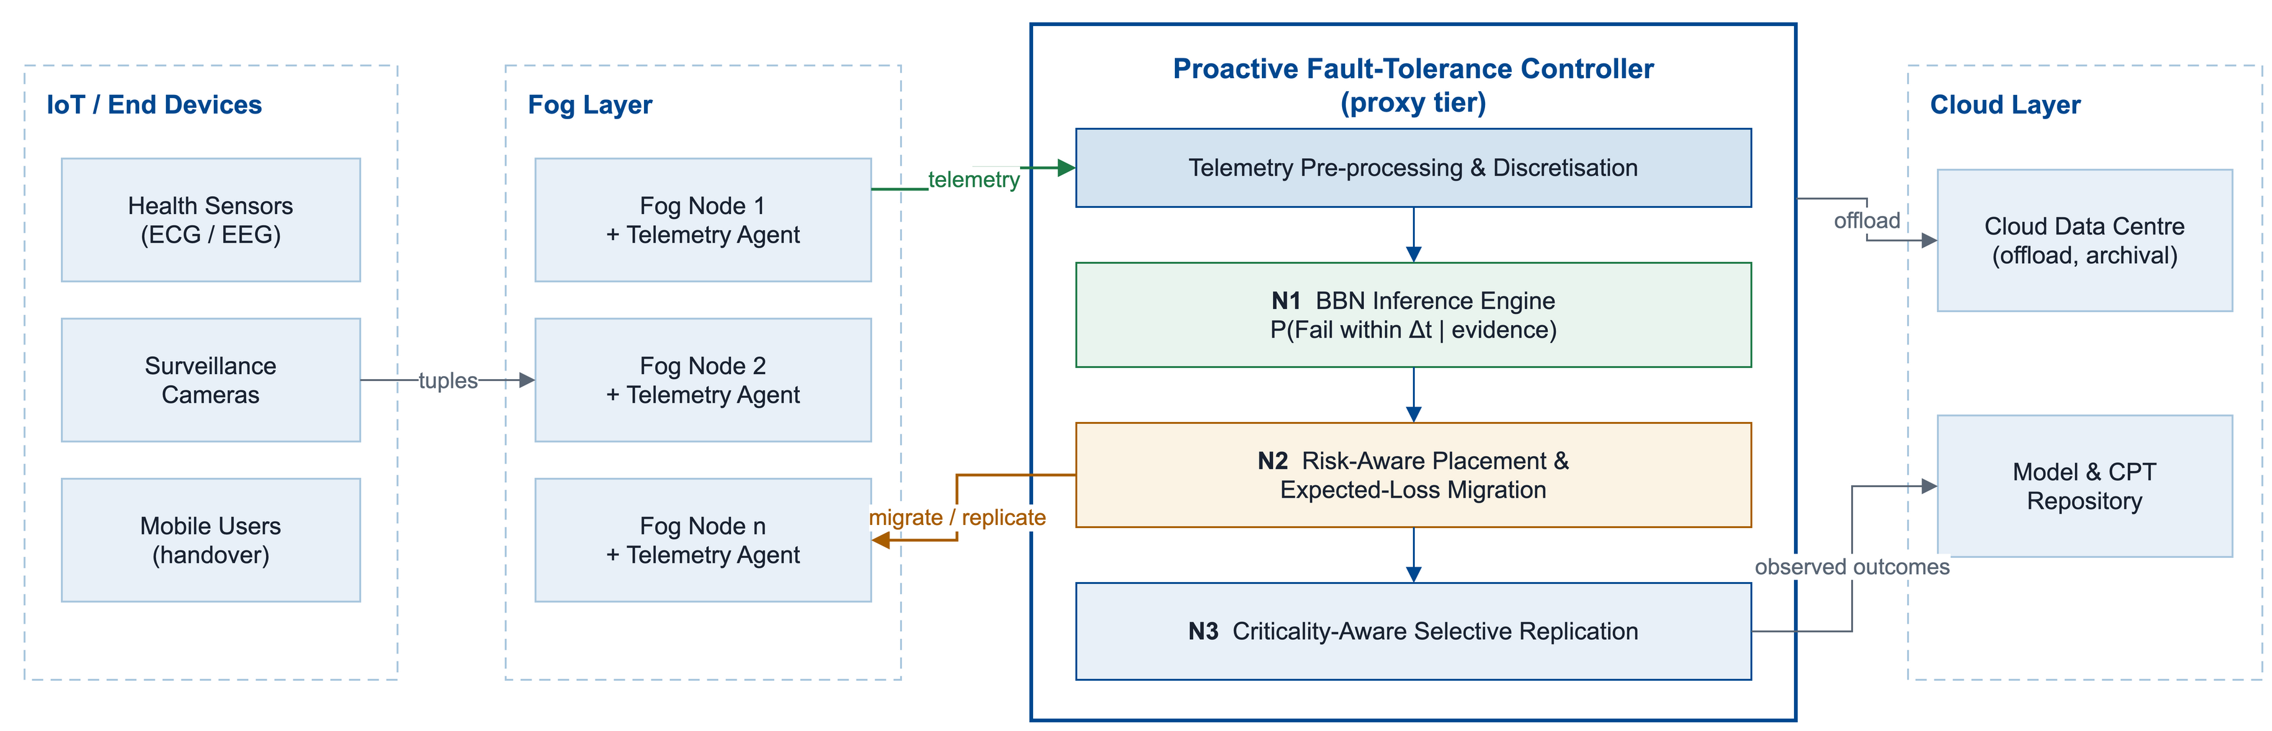
Methodology — System Architecture
The Proactive Fault-Tolerance Controller sits at the proxy tier, above a cluster of fog nodes
Telemetry flows up from every fog node; placement, migration and replication decisions flow back down.
Notes:
(~60 sec) Walk the diagram left to right.
LAYOUT: IoT devices on the left send tuples into the fog layer. Each fog node runs a lightweight telemetry
agent. The cloud on the right is for offload and for the model/CPT repository.
In the centre is our Proactive Fault-Tolerance Controller. It sits at the PROXY tier, because from there it
can see a whole cluster of fog nodes without paying the round trip to the cloud.
INSIDE THE CONTROLLER: pre-processing discretises the telemetry; N1 is the BBN inference engine that returns
P(fail | evidence); N2 turns that into placement and expected-loss migration; N3 assigns a redundancy tier.
Observed outcomes go back to the cloud repository, so other clusters benefit from what this one learned.
The three N-blocks are the three novelties - say the number as you point at each.
(Figure drawn in draw.io: figures/methodology_architecture.drawio)

Slide 9
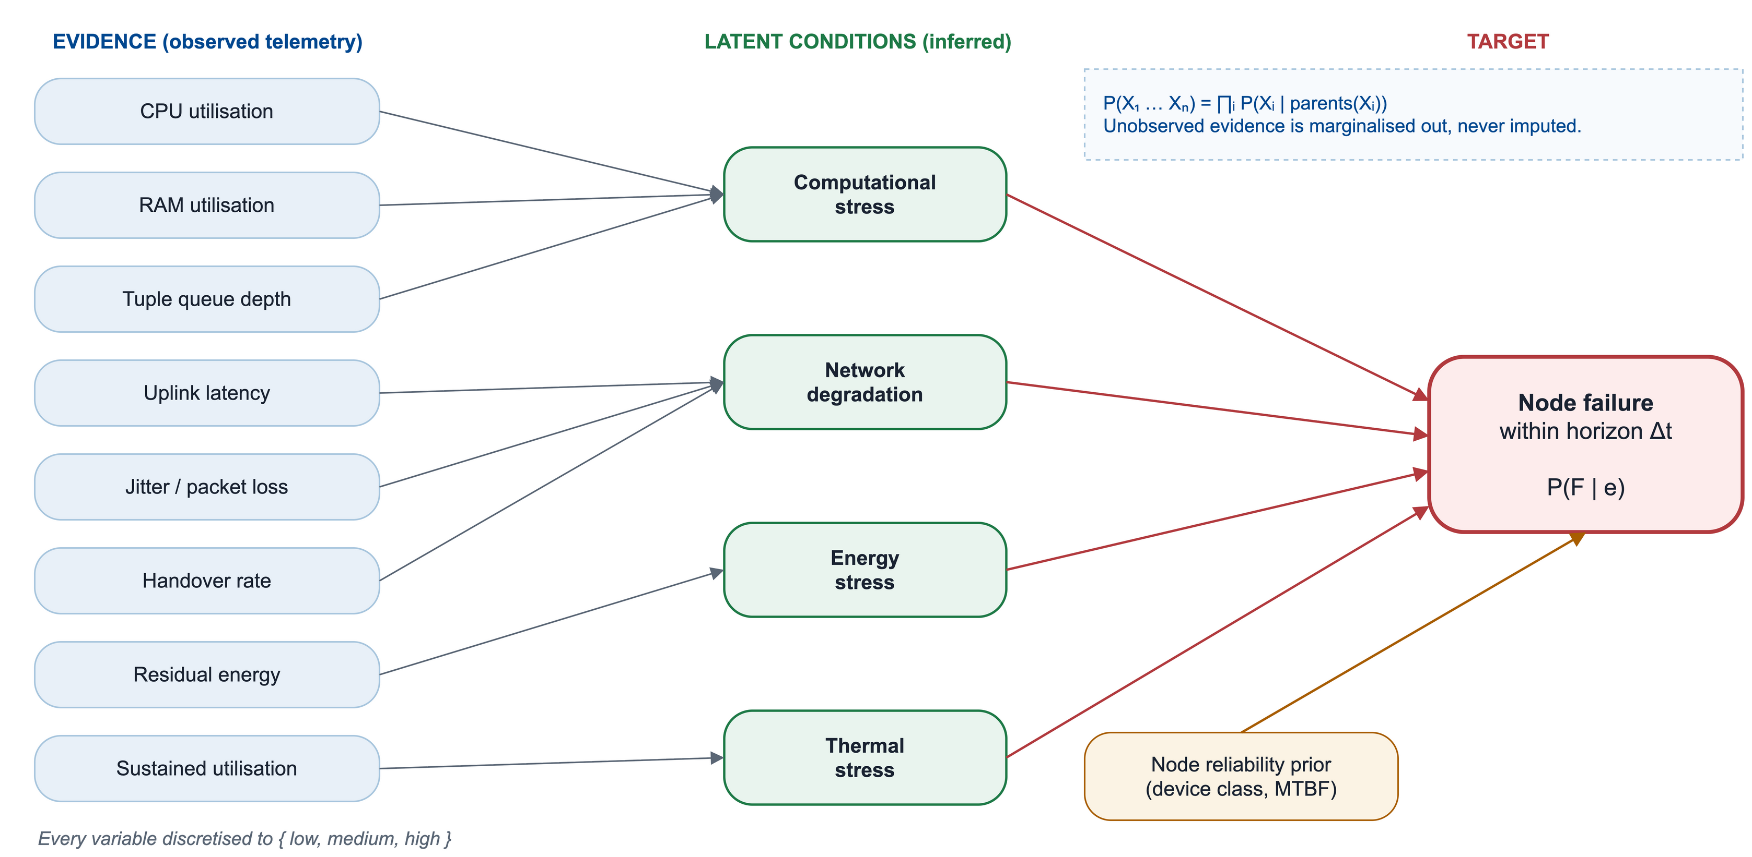
Methodology — The Bayesian Belief Network
Why a Bayesian Belief Network
Where the numbers come from
• ~1.6 M joint entries collapse to a few hundred, factorised
• Exact inference; missing evidence is marginalised out
• Causal — it names the condition driving the risk
• Structure from domain knowledge, not learned from data
• Initial CPTs seeded from the reliability literature
• Refined online by Dirichlet parameter updating
Notes:
(~90 sec)
NETWORK STRUCTURE - three tiers, left to right.
Left: evidence we observe (CPU, RAM, queue depth, uplink latency, jitter/loss, residual energy, handover
rate, and sustained utilisation as a proxy for temperature - iFogSim2 has no thermal sensor).
Middle: four LATENT conditions we never measure directly but infer - computational stress, network
degradation, energy stress, thermal stress.
Right: the target - does this node fail within Delta-t, also conditioned on a node-reliability prior from
device class and historical MTBF.
DISCRETISATION - every variable becomes low/medium/high, which keeps the CPTs small enough to read and to
elicit from an expert.
THE FACTORISATION - 13 variables at 3 states is roughly 1.6 million numbers as a full joint; factorised over
this sparse graph it is a few hundred. That reduction is why Bayesian networks are usable at all.
THE KEY PROPERTY - inference is exact, and anything unobserved is MARGINALISED OUT, not imputed. If jitter is
not reported this epoch we sum over its states and the posterior comes out slightly less sharp. An SVM or a
neural network needs a value in every slot, so you must impute - and imputing for a channel that went
silent BECAUSE the node is in trouble is exactly the wrong guess. Lead with this if challenged on model
choice.
WHERE THE NUMBERS COME FROM - structure from domain knowledge (no failure corpus to learn it from); initial
CPTs from the reliability literature and expert elicitation; refined online by Bayesian parameter learning
with Dirichlet priors, which is conjugate, so updating is just adding counts.
IF PRESSED ON CPT SIZE - the failure node has five parents at three states, so 3^5 = 243 rows, the largest
table in the network. The remedy if it grows is a noisy-OR formulation: linear in the parents, not
exponential. Naming noisy-OR unprompted signals you understand the limitation.
(Figure drawn in draw.io: figures/bbn_model.drawio)

Slide 10
Methodology — Decision Rules
Placement — score every candidate node
U(m, n) = α (1 − latency) + β (1 − energy) + γ (1 − P(F | e))
• Risk enters the score directly; weights are set per application class
Migration — move only when it pays
E[loss | stay] = P(F | e) · C_fail E[loss | migrate] ≈ C_migrate
• Migrate when P(F | e) · C_fail > C_migrate — no threshold is chosen, it falls out of the cost ratio
Replication — spend redundancy where risk meets criticality
R(m) = P(F | e) × κ(m) → warm-standby | checkpoint-only | no redundancy
• Tiers are recomputed each epoch, so reserved capacity follows the risk over time
Notes:
(~90 sec) Three rules, one per novelty. This slide carries the review - deliver the migration rule well.
PLACEMENT - score each candidate with U = a(1-latency) + b(1-energy) + g(1-P(F|e)). Weights depend on the
application class: a health module gets a large gamma so it avoids fragile nodes. Risk sits in the score
itself, so a fast node that is about to fail does not win.
MIGRATION - this is the best answer you have, because every paper you surveyed struggles with its threshold.
Migrating is not free: bandwidth, a brief interruption, possibly a worse host. So compare expected losses.
Staying costs P(fail | e) x C_fail. Migrating costs about C_migrate. Move when staying is worse.
Rearranged, the effective threshold P* IS the cost ratio - it is DERIVED, not tuned, and it differs from
module to module. This directly answers the weakness in [1] and [3].
REPLICATION - R(m) = P(F|e) x criticality puts each module into warm-standby, checkpoint-only, or no
redundancy. Redundancy is a budget to spend, not a backup reserved for everything. Tiers are recomputed as
the posteriors move, so reserved capacity follows the risk.

Slide 11
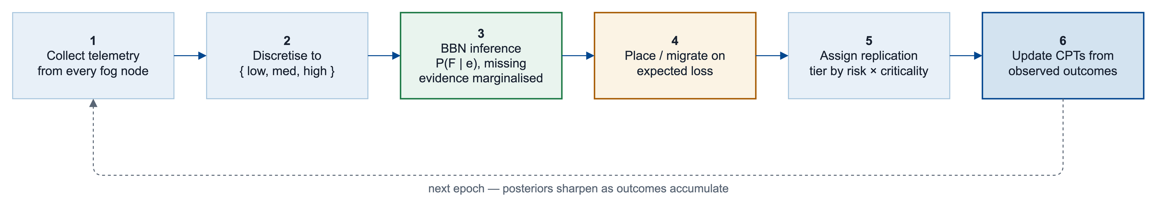
Methodology — Execution Flow per Epoch
What runs at each decision epoch
• Steps 1–3 are inference: telemetry in, a posterior P(F | e) per node out
• Steps 4–5 are control: placement, migration and replication act on that posterior
• Step 6 closes the loop — outcomes update the CPTs, so the model sharpens as the run proceeds
Notes:
(~60 sec) Walk the six numbered steps, then point at the feedback arrow.
1. Collect telemetry from the agents on every fog node.
2. Discretise it into the states the network is defined over - quantiles of the baseline runs.
3. The BBN inference engine computes P(fail | evidence), marginalising whatever is missing <- Novelty 1.
4. Risk-aware placement and expected-loss migration turn that into a decision <- Novelty 2.
5. Criticality-aware replication assigns a redundancy tier <- Novelty 3.
6. We observe what actually happened and update the CPTs, then sync them to the cloud repository so other
clusters benefit from what this one learned.
Steps 1-3 are inference; steps 4-5 are control; step 6 closes the loop, which is why the posteriors sharpen
as the run proceeds. Everything in the loop is per-epoch, so it runs inside the deadline.
(Figure drawn in draw.io: figures/methodology_flow.drawio)

Slide 12
Dataset Description
What the dataset contains
• edgeResources-melbCBD.csv — 131 real edge sites (lat, lon, block, level, parent)
• usersLocation-melbCBD_1.csv — 87 real user positions; 5 synthetic traces of 100 each
• ApplicationConfig.json — 10 microservice profiles: MIPS, network load, deadline
How iFogSim2 builds the devices
• Each row becomes a FogDevice through createFogDevice()
• Four levels give 1 cloud, 12 block proxies, 118 gateways and mobile devices
• Sensors (ECG, EEG, camera) and actuators attach at level 3 and emit tuples
Tier (level) | What it represents | MIPS | RAM (MB) | Uplink BW | Busy / Idle W
Cloud (0) | Cloud data centre, 1 node | 44 800 | 40 000 | 100 | 1 648 / 1 332
Proxy (1) | Block proxy servers, 12 nodes | 2 800 | 4 000 | 10 000 | 107.34 / 83.43
Gateway (2) | Cell-site gateways, 118 nodes | 2 800 | 4 000 | 10 000 | 107.34 / 83.43
Mobile (3) | Phones, cameras, ECG and EEG nodes | 200 - 1 000 | 1 024 - 2 048 | 10 000 | 87.53 / 82.44
Notes:
(~90 sec) START BY DEFINING THE WORD "DATASET".
iFogSim2 is a SIMULATOR, not a machine-learning tool. So this dataset is not training data. It DESCRIBES THE
ENVIRONMENT we simulate: where the fog nodes are, how they connect, and how users move.
WHAT IT CONTAINS:
* edgeResources-melbCBD.csv - 131 rows, one per computing resource in the Melbourne central business
district. Each row has latitude and longitude, the city block, its level in the hierarchy, and its parent.
These are real cell-site locations.
* usersLocation - 87 recorded user positions; five synthetic traces add 100 positions each so we can scale up.
* ApplicationConfig.json - the applications themselves: ten microservice profiles, each with the MIPS the
module needs, the network load on its edges, and its deadline.
HOW iFogSim2 BUILDS THE DEVICES:
* Every CSV row becomes a FogDevice object. createFogDevice() builds a processing element (a CPU core rated
in MIPS - millions of instructions per second), a power host that owns RAM and bandwidth, and the device
characteristics for that tier.
* The four levels give 1 cloud data centre, 12 block proxy servers, 118 cell-site gateways, and the mobile
devices under them. Each device has a parent one level up, and each link has a latency - that is how
end-to-end delay is computed.
* Sensors (ECG, EEG, camera) and actuators (a display, a pan-tilt-zoom motor) attach at level 3. Sensors
emit the tuples; the modules process them; the actuator consumes the result.
THE TABLE - what each tier is given. Point at the gap: the cloud has 44,800 MIPS, a gateway only 2,800. That
is exactly why placement matters and why a gateway saturates. Busy/idle watts feed the energy model.

Slide 13
Simulating Conditions and Failures in iFogSim2
How different conditions are produced
• Load varied through modules per node and the MIPS each one needs
• Network conditions from configured link latency and uplink queueing delay
• Mobility traces move users between gateways, shifting load during a run
How failures are introduced
• No public failure trace exists, so a harness injects failures into iFogSim2
• A hazard function over true load, energy and link state decides when a node dies
• The BBN never sees that state — only sampled, discretised, sometimes missing telemetry
Cases simulated in the evaluation
• Baseline run with no failures, for normal loop delay and energy
• Single-node failures at proxy and gateway tiers, under light and heavy load
• Runs with telemetry withheld, and with more users, so handovers change the load
Notes:
(~90 sec) THIS SLIDE ANSWERS: "where do your failures come from?"
HOW WE CREATE DIFFERENT CONDITIONS - if every node idled, there would be nothing to predict.
* Load: change how many modules sit on a node and how much MIPS each needs.
* Network: the configured link latency, plus the queueing delay that builds up when tuples pile on the uplink.
* Energy: iFogSim's linear power model, P(u) = idle + (busy - idle) x u, where u is utilisation from 0 to 1.
A node that stays busy drains its residual energy faster.
* Mobility: the traces move users between gateways, so the load a node carries changes during the run.
HOW FAILURES ARE INTRODUCED:
* Say the limitation FIRST: there is no public failure trace for a fog topology like this. So we add our own
fault-injection harness to iFogSim2.
* A node is failed using a HAZARD FUNCTION over the simulator's true internal state (load, energy, link).
A hazard function is simply the instantaneous rate of failure given the node has survived so far - a
stressed node is more likely to be killed at the next step. The record of what failed and when is our
GROUND TRUTH for scoring predictions.
* THE KEY LINE: the Bayesian network never sees that internal state. It sees only telemetry - sampled at
intervals, discretised, delayed and sometimes missing. So it is genuinely inferring, not reading the
answer key. (This pre-empts the "isn't that circular?" question.)
CASES WE RUN: a baseline with no failures for reference numbers; single-node failures at the proxy and gateway
tiers under light and heavy load; runs with telemetry channels withheld (tests the marginalisation claim);
and runs with more users and mobility.

Slide 14
From Simulator State to BBN Evidence
• Every evidence variable is computed from a quantity that iFogSim2 already tracks during a run.
Evidence variable | Quantity in iFogSim2 it is derived from | Latent condition it feeds
CPU utilisation | Allocated MIPS against host PE capacity, per scheduling interval | Computational stress
RAM utilisation | RamProvisionerSimple allocation against available RAM | Computational stress
Tuple queue depth | Length of the pending tuple queue on the device | Computational stress
Uplink latency and jitter | Configured link latency plus queueing delay on the uplink | Network degradation
Residual energy | FogDevice energy consumption against a configured budget | Energy stress
Handover rate | Parent reassignments per window, from LocationHandler | Network degradation
Node reliability prior | Device class (cloud, proxy, gateway, mobile) and its MTBF | Parent of the target
• All variables are binned into low, medium and high, using quantiles of the baseline runs.
• Thermal stress is inferred from sustained utilisation, as iFogSim2 has no temperature sensor.
Notes:
(~75 sec) THE POINT OF THIS TABLE: every input the network needs is something the simulator already
tracks. We are not assuming data we cannot get.
ROW BY ROW:
* CPU utilisation = allocated MIPS / the host's processing capacity, measured each scheduling interval.
(2,100 used out of 2,800 = 0.75.)
* RAM utilisation - RamProvisionerSimple is the CloudSim/iFogSim class that hands memory to modules; ask it
how much it has allocated against how much exists.
* Tuple queue depth - how many tuples are waiting on the device. A growing queue means the node cannot keep up.
* Uplink latency and jitter - the configured link latency plus queueing delay. Jitter is the variation in it.
* Residual energy - the FogDevice's cumulative energy consumption against a configured budget.
* Handover rate - how many times users were reassigned to a different parent in the last window. iFogSim2's
LocationHandler tracks positions and parents.
* Node reliability prior - NOT measured. It is a starting belief from the device class (a cloud data centre is
more reliable than a phone) and its configured MTBF.
THIRD COLUMN links back to the previous slide: CPU, RAM and queue depth all feed COMPUTATIONAL STRESS;
latency and handovers feed NETWORK DEGRADATION; energy feeds ENERGY STRESS.
TWO NOTES: everything is binned low/medium/high, and the bin edges come from the QUANTILES OF THE BASELINE
RUNS - so "high CPU" means high FOR THIS TOPOLOGY, not an arbitrary 80%. And thermal stress has no sensor in
iFogSim2, so we infer it from sustained utilisation. We state that openly rather than hide it.

Slide 15
Evaluation Plan, Baselines and Work Plan
Evaluation metrics
Prediction quality
System quality
• Precision, recall and F1 within Δt
• Calibration against observed frequency
• Lead time before the actual failure
• Robustness when telemetry is withheld
• Loop delay and deadline-violation ratio
• Energy across cloud, fog and device tiers
• Service downtime per injected failure
• Reserved standby capacity as overhead
Baselines for comparison
Work plan
1. Cloud-only placement
2. iFogSim2 edgeward placement, no fault tolerance
3. Reactive checkpointing and replication [1]
4. Threshold-based proactive migration, FTAPA [3]
• Done: survey, iFogSim2 set up, baseline runs, design
• Next: build and validate the BBN and its CPTs
• Next: inference engine and fault-injection harness
• Next: placement, migration and replication policies
• Next: comparative evaluation against the baselines
• Baseline 4 separates probabilistic inference
from simply acting early.
Notes:
(~75 sec)
PREDICTION QUALITY - precision, recall and F1 within Delta-t; calibration (if we say 0.7, does it fail 70% of
the time?); lead time, because a prediction that arrives too late is worthless; and robustness when we
deliberately withhold telemetry channels.
SYSTEM QUALITY - mean and tail loop delay and the deadline-violation ratio; energy across cloud, fog and
device tiers; service downtime per injected failure; and redundancy overhead, meaning how much standby
capacity we reserved.
BASELINES - cloud-only; iFogSim2's own edgeward placement with no fault tolerance; reactive checkpointing and
replication [1]; and threshold-based proactive migration, FTAPA [3]. Baseline 4 is the important one: it
separates the benefit of PROBABILISTIC INFERENCE from the benefit of simply ACTING EARLY.
WORK PLAN - be precise and do not overstate. Done: the survey, the iFogSim2 environment, the baseline fog vs
cloud runs, and the framework design. Remaining: build and validate the network and its CPTs, the inference
engine and the fault-injection harness, the three policies, then the comparative evaluation. The BBN
implementation is Phase II - that is the plan, not a slip.

Slide 16
References
[1]
H. T. Rajab and M. F. Younis, “Dynamic fault tolerance aware scheduling for healthcare system on fog computing,” Iraqi Journal of Science, vol. 62, no. 1, pp. 308–318, 2021.
[2]
M. H. Naim, J. M. Zain and K. A. Jalil, “Fault tolerance mechanism for software application through fog computing as middleware,” Int. J. Computing and Digital Systems, vol. 5, no. 3, 2016.
[3]
S. Gupta and N. Singh, “Optimized fault-tolerant placement of microservices in distributed fog networks,” IJDIIC, vol. 4, no. 4, pp. 52–69, 2025.
[4]
N. Fenton, M. Neil and D. Marquez, “Using Bayesian networks to predict software defects and reliability,” Proc. MMR07, Glasgow, 2007.
[5]
P. Weber, G. Medina-Oliva, C. Simon and B. Iung, “Overview on Bayesian networks applications for dependability, risk analysis and maintenance areas,” Eng. Appl. Artif. Intell., vol. 25, no. 4, pp. 671–682, 2012.
[6]
P. A. Aguilera et al., “Bayesian networks in environmental modelling,” Environmental Modelling & Software, vol. 26, no. 12, pp. 1376–1388, 2011.
[7]
R. Mahmud, S. Pallewatta, M. Goudarzi and R. Buyya, “iFogSim2: An extended iFogSim simulator,” J. Systems and Software, vol. 190, art. 111351, 2022.
[8]
H. Gupta, A. V. Dastjerdi, S. K. Ghosh and R. Buyya, “iFogSim: A toolkit for modeling and simulation of resource management techniques,” Software: Practice and Experience, vol. 47, no. 9, pp. 1275–1296, 2017.
Notes:
(~10 sec)
These are our references: the six surveyed papers, plus the two iFogSim papers for the simulator itself.
Do not read them out. Move on unless asked.

Slide 17
Thank You
Notes:
(~10 sec)
Thank you. We are happy to take questions.
MOST LIKELY QUESTIONS: where is your failure data (no public trace - we inject, and we say so); isn't it
circular (harness sees internal state, BBN sees only degraded telemetry); why not deep learning (no labelled
failure corpus exists, and it is not explainable); how do you get the CPTs (expert elicitation plus the
reliability literature, then online updating); what is the inference cost (about 13 variables, near-polytree,
milliseconds, once per node per epoch, not per tuple); what if the controller fails (fog nodes fall back to
their last placement; CPTs are synced to the cloud; distributed inference is future work).

